Slide 1
All Roads Lead to a Cherry Farm
Scoping & Sustainable Design towards
Business Plan 2024
Ist Draft SNJ 240122

Slide 2
Highlights
Cherry Production has by far the best potential financially: 10 Ha gross production income EUR 54,560 – EUR 627,250 p.a. Production costs say EUR 62,000 p.a. upwards (70% labour so innovative employment of volunteers/students during development phase possible).
Current cherry crop (Vall de Gallinera, Planes) not currently economically viable, principally because of climate change (cross-over of pollinator trees flowering at the same time as cultivator trees for essential pollination).
Cost of land purchase with adequate farm building (on the current market but not apparently selling) 15k per Ha.
Cost to rent?
Technologies to optimise production and production efficiency exist and can be implemented step by step e.g. artificial pollination, orchard design and pruning (transition to 2D design similar to vineyards)
Sarah informally met with the Agri Cooperatives in the Vall de Gallinera, Valencia Province, Spain in October 2023. Leaders are provisionally open to work on recovery/optimisation of stone fruit and other crops in the face of climate change in the valley.

Slide 3
Objectives (To depersonalise)
200,000+ Euros family profit p.a at Years 3-5
Base to register EU Company; Spanish Working Visa for Sarah at Year 1 and Residency at Year 5; Space for Cheekies and Horses; EU working visa for e.g. Amber Rees.
Climate Change and Biodiversity Agri-Adaptation Model for Vall de Gallinera and adjacent villages/towns
Best practice sustainable business/investment model for further fund design and governance
Capital and Real Case for Clarity’s True Value Chain Software (real time semantic information financial, economic, ESG, Sustainable Development Goals)
Scaling by adapting Los Grobos farming model (currently US$ 500 million+)
Warehouse location near to Alicante port for EU Agro-forestry imports from Africa

Slide 4
Location
Within 1 hr drive of Alicante Airport and 1 hr drive of Santa Ana Beach (between Oliva Nova & Denia)
Irrigation water, well water, ideally drinking water
Easy lorry access
Great views
Walk out the door nature trails, horse riding trails, biking, as close to the coast as viable (trade off for land quality/crop).
Ideally no mosquitos or minimal

Slide 5
Opportunities
Dr Sarah Jones has over 25 years of experience working to strengthen local rural economies by working in the nexus of natural resource management, nature conservation, climate change adaption, technological development, local knowledge, sustainable business planning and design, grant funding and financial investment with outstanding results with ‘beyond state of the art’ strategies. Sarah co-designed and has achieved co-financing for:
Invest in Fish EUR 2 M 2004-2007 (Bio-econonic modeling of fish stock recovery plan scenarios from stakeholders and scientists, EU principle funder) speared headed by (now) King Charles III.
Wild Places Business Plan Patagonia & Atlantic Rainforest EUR 10 M 2004-2018 (Adjacent community financial mechanisms for protected nature area management, National Postcode Lottery – Netherlands principle finance) with protected nature areas now covering over 10% and 3% of Argentine sovereign territory (land and sea respectively, including from 0% marine protected areas in 2004).
Serious Shea Deforestation Free, Carbon Zero, Beyond Fairtrade Value Chain Business Plan EUR 16 M achieved/loi of EUR 100 M (World Bank; African Development Bank; Mirova Sustainable Investment Fund, others). Delivered in some of the most challenging global logistics, Serious Shea focuses on the transition to sustainable agro-forestry where the Serious Shea company takes responsible for investment in reforestation, clean-energy processing centres, distribution and marketing which is part delivered through community cooperative instruments. The co-design with agri-tech entrepreneur William Kwende won the United Nations and World Economic Forum ‘Sahel and the Great Green Wall Africa Challenge’ – Top Innovator - in 2020.
Sarah informally met with the Agri Cooperatives in the Vall de Gallinera, Valencia Province, Spain in October 2023. Leaders are provisionally open to work on recovery/optimisation of stone fruit and other crops in the face of climate change in the valley. The cherry crop collapsed in 2023, it seems principally because flowering of pollinator trees did not adequately coinside with flowering of cultivator trees for essential cross pollination because of climate change.
Financing for climate change adaptation in rural communities is available from various sources including EU funding streams. Cost of land purchase and renting per Ha in the Vall de Gallinera and surrounding villiages is competitive (e.g. compare with Turkey, other parts of Spain, supply chain costs to direct markets quantify).
Simon Jones (MA, ACA) has over 25 years of global investment fund management (up to EUR 1 Billion), since 2009 with Cognis Capital. Simon has been involved with some of the most complex operational and financial restructuring assignments in recent years and has experience across a number of European jurisdictions, the Far East and South East Asia. . Simon’s experience of working with financially and operationally challenged companies and their stakeholders has given him a strong understanding of the fundamental drivers of business performance as well as a critical insight into the dynamics between the investors at various levels in companies’ capital structures.

Slide 6
Crop 1. Cherries
Production in the literature ranges from 4T per Ha to 10T per Acre (24T per Ha) see Big Cherries Big Commitment , assuming risks are mitigated
Spanish cherry prices (farm gate) 2018-2022 May – August range from EUR 2509 (May before 2022)- EUR 1364 (August before 2022). UN FAOSTAT Advantage of the climate in Vall de Gallinera is first crop cherries May achieve the highest prices. Main competition this time of year is from Turkey.
Markets….
Production costs are relatively high in Vall de Gallinera e.g. because of terraced land. Say EUR 8,500 per Ha where as elsewhere costs of EUR 6,200 per Ha are quoted. Land is flatter 30km further inland e.g. Alcoi, Muro de Alcoi with good access to the motorway system e.g. A7 to Alicante Port and Airport and Alcocer de Planes Airfield.
Production gross income p.a. at lowest production and lowest price EUR 5456 per Ha at the highest production and highest price EUR 62,725 per Ha.
Say 10 Ha gross production income EUR 54,560 – EUR 627,250 p.a. Production costs say EUR 62,000 upwards (70% labour).
Risks are high causing a collapse of production in Vall de Gallinera in 2023 it seems mostly because pollinator flowers are not coinsiding with cultivator flowers for essential cross pollination (climate change).
* Compares to Olives say EUR 1200 per Ha; Almonds 12-20k per Ha UN FAOSTATUN FAOSTAT

Slide 7
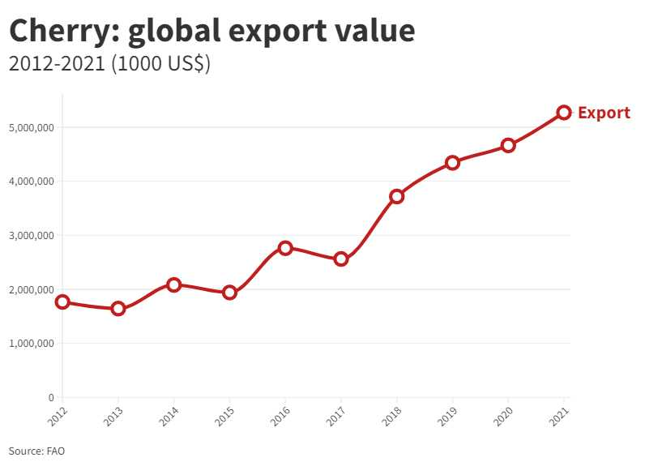
Global cherry export values rising steadily and significantly higher than Spanish average

Slide 8
Risks (Challenges)
EXTERNAL
Climate Change/Biodiversity loss
- rain during the flowering season
- summer droughts
- pollinator trees flowering at a different time than cultivator trees
- few bees/other pollnators
Pests and disease
- Fruits flies Drysolphila suzukii
- Fungi
- Rats
Labour availabilty particularly for picking May-June (30 people per acre per day, reduced by almost 50% with transition to 2D pruning and cultivation, similar to vines )
INTERNAL
Labour availabilty particularly for picking May-June (30 people per acre per day, reduced by almost 50% with 2D pruning)
Capital
- Transition to new and best practice technologies (e.g. multi-use covers, vehicles, drip fertigation, clean energy, real time data)
Cash Flow
Paying significant labour (est 70% costs 6 months in advance of return)
Day to day skill sets & commitment to optimise production efficiency and protect fruit during picking/packing

Slide 9
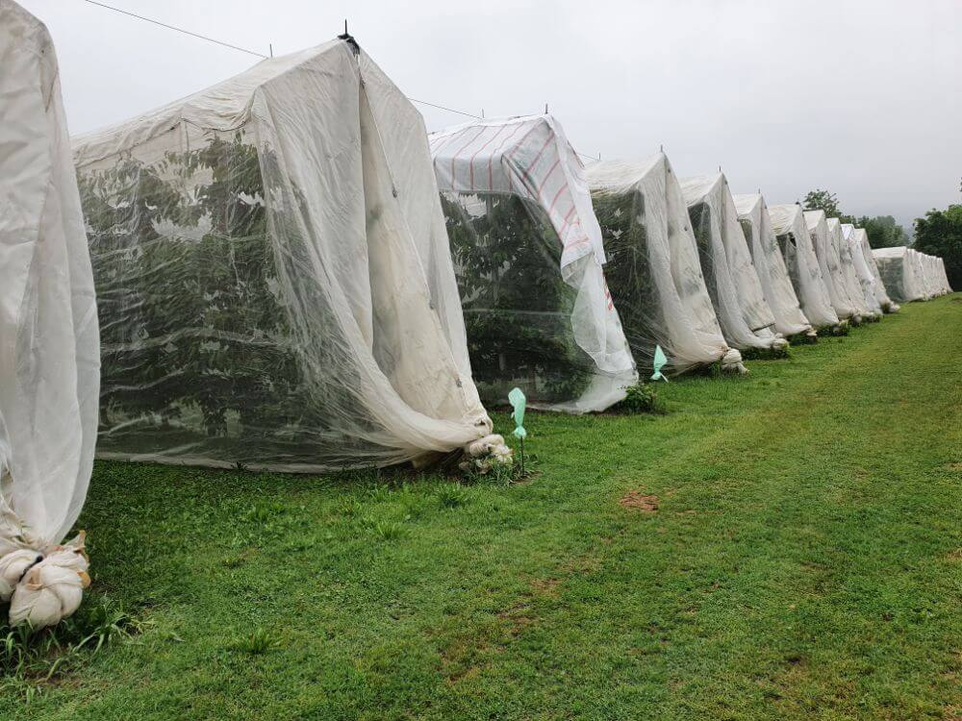
Risk Mitigation
Artificial pollination
Bee hives/additional wild flowers
Drip irrigation
Fertilizer from horse manure and biochars
Pruning for one year wood
Pest control e.g. for fruit flies (Drysolphila suzukii) to include organic pesticides (e.g. neem)
In situ lab, real time software to test/measure pollination of stamins, pests, soil nutrients and water content.
Research for added -value products e.g. cherry gin (minimum EUR50K for good still).
Cluster income e.g. horse liveries, Annual Cherry Music Festival, biking, hiking, crop diversification (to research),
Option: Multi Function Covers

Slide 10
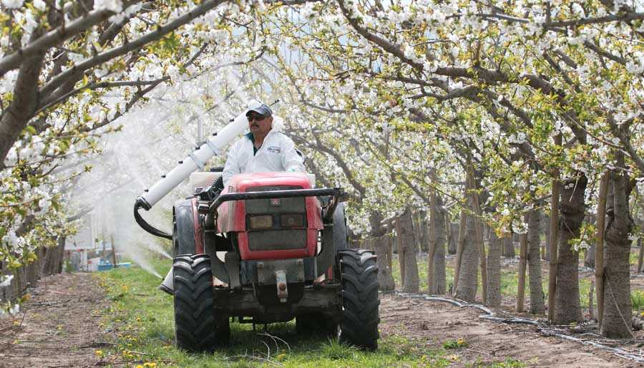
Artifical Pollination
No Bees but a lot of buzz about artifical pollination video
After two years of experimenting, a stone fruit physiologist and his collaborators believe they have developed an effective artificial pollination system that uses an electrostatic sprayer to apply a suspension of pollen to flowering fruit trees (2016). This supplements pollination by bees.
Q. Smaller version attached to a backpack at start?

Slide 11
Pollination: Detailed Research
Fruit Set of Date Palm
Abstract
Success artificial pollination with viable pollen is crucial process in the production chain of date palms. This study evaluated the impact of pollen storage temperature and duration, pollination time following spathe cracking, and the hour of daytime on pollen viability, germinability, fruit set and yield of 'Deglet Nour' date palm cultivar. In in vitro tests, fresh pollen showed the maximum viability (96.3%) and germination (85%) but it decreased thereafter upon the storage temperature (28, 4 and −30 °C) and duration (3, 6, 9 and 12 months). In this respect, pollen stored at −30 °C retained highest viability and germinability followed by those stored at 4 and then at 28 °C. In filed experiments, fruit set was 85, 75, 65, and 45% with pollination using fresh pollen, or pollen stored at −30, 4 and 28 °C, respectively. Fruit set was 95%, 75%, and less than 50%, for pollination performed on the same day of spathe cracking, 6 and 12 days later, respectively. The highest fruit set percentage and yield/bunch were obtained with pollination performed between 12.0 pm and 15.0 pm in contrast to 8.0–11.0 am or 16.0–17.0.
At a garden level cuttings from another tree video

Slide 12
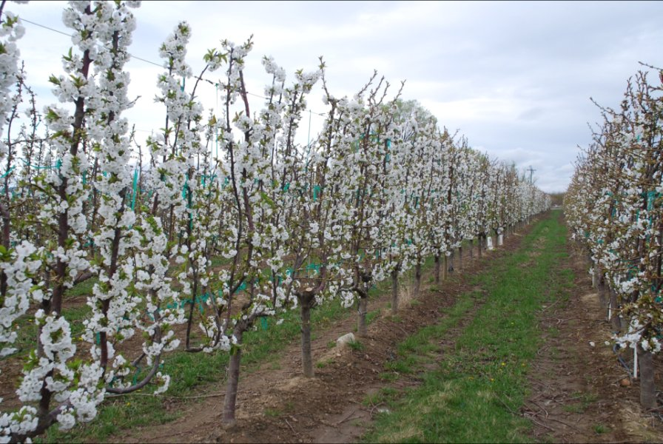
Tree Training & Pruning
Training Trees
In the new competitive orchard system upright fruiting wood and small, repeated fruiting units allow training and pruning to be governed by simple, easy-to-follow rules.
We need to create a compact wall of fruit that bears fruit on year-one wood. This concept has an emphasis on dwarfing rootstock and looks a lot like the vertical shoot position training used for grapes.
The leader is trained horizontally to a wire, planting at 30 to 45 degrees assists this
Produces 10.6 T per acre! 9.5 Row or larger
Renewal Pruning
Traditonal to Transformative Growing Practice

Slide 13
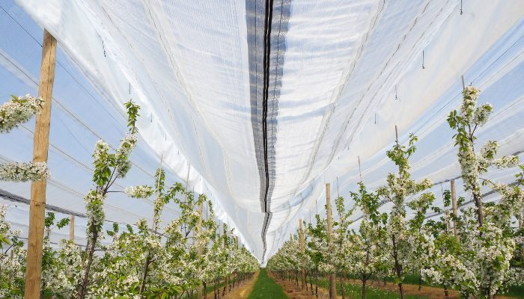
Cherry Tree Multi-purpose Covers
Starting with the types of covers, I would divide them into two groups: the first group comprises high-density polyethylene covers used as roofs for cherry trees. Additionally, there are macro tunnels, generally made of low-density polyethylene, and greenhouses. The other group involves the use of mesh, initially using Rachel mesh and now utilizing monofilament mesh.
Cost: Unviable at start EUR 30,000 per acre 3.5M wide
Solution: experiment with 1 row in Year 1.
See SMART Cherry July 24 2023
00

Slide 14
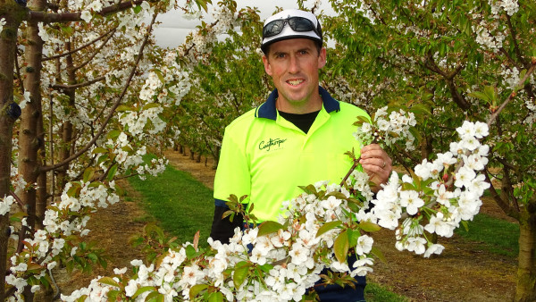
Innovating for the perfect cherry, every time (Case Study)
NZ 2022
4Ha cherry orchard has upright shooting offshoot (UFO) growing system.
Installing 1.5-metre-wide rain covers for each row as extra insurance (unviable economically at start with prices quoted upwards of EUR 28K per acre, in this article NZ$200 per Ha I.e. EUR 48k per acre).
Picking UFOs is almost 50% faster than leader trees.
At 4Ha he cherry orchard is a small fraction of the business which encompasses 140 hectares of vineyard and 45 hectares for stock and hay but in a good year, the cherry crop can return five times the value of grapes on a per hectare basis.
Renewal Pruning

Slide 15
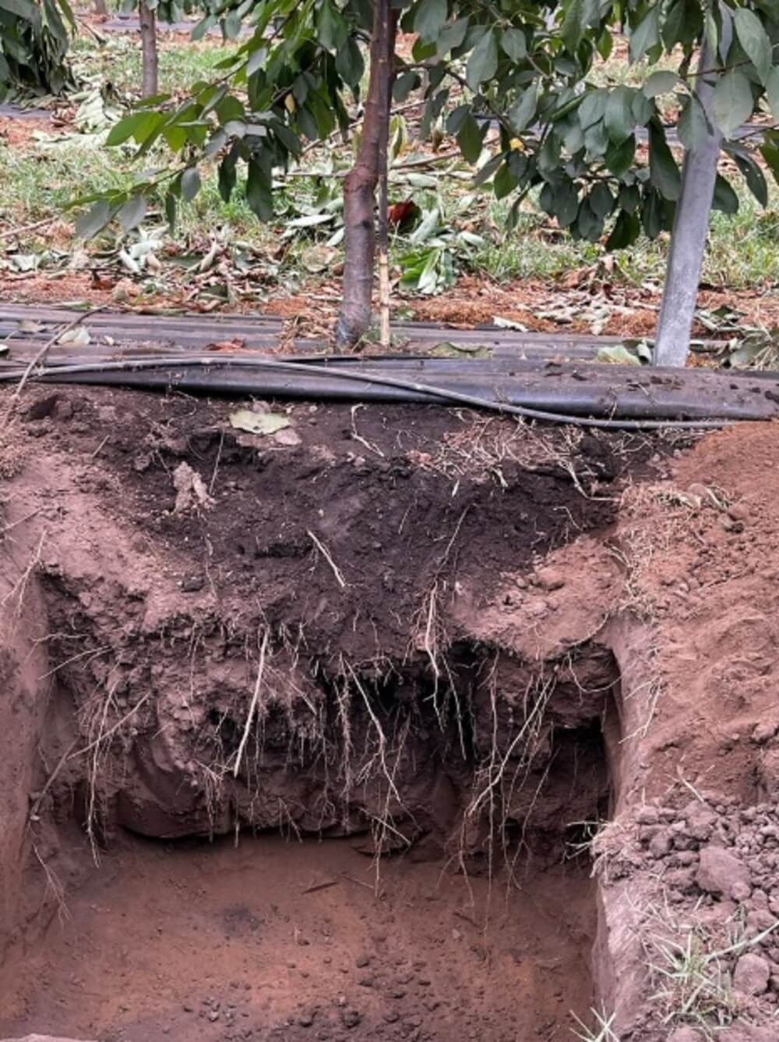
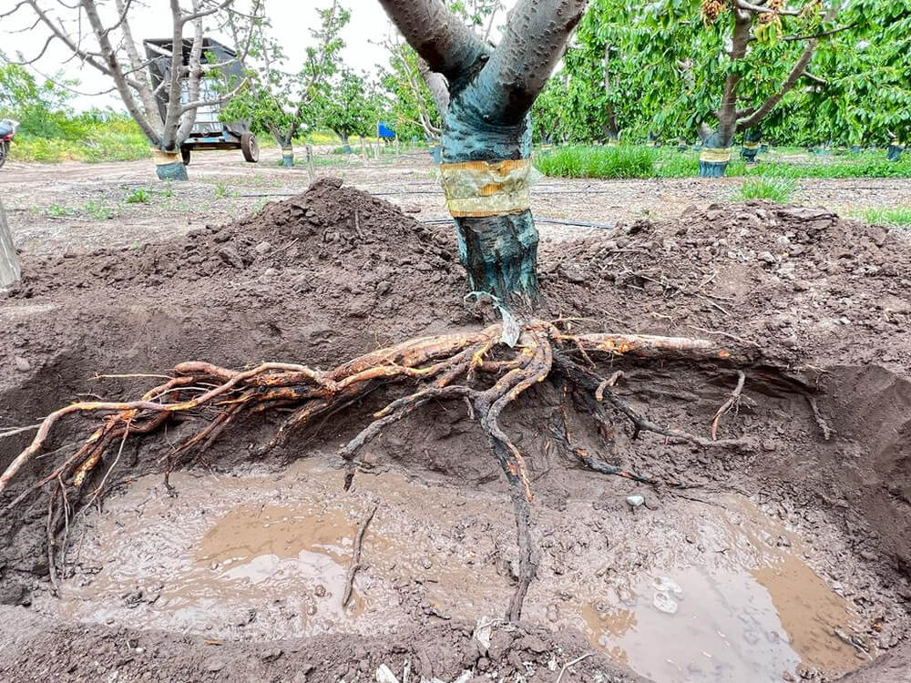
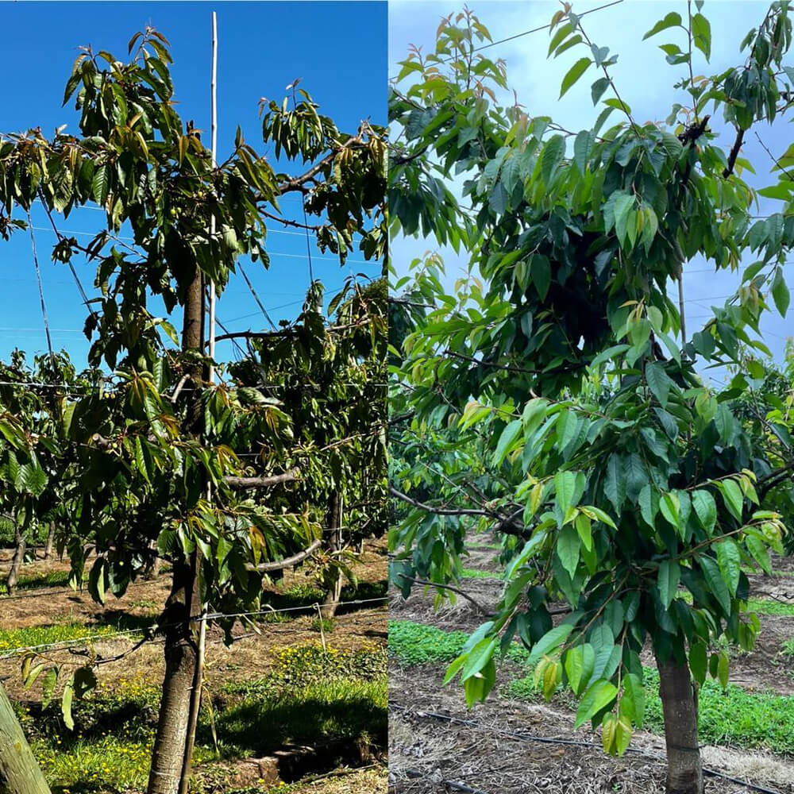
Diseases & Poor Practices
Orchard showing disease and phytosanitary (i.e. plant disease) symptoms in 2,3 4 year
Orchard with little physical soil preparation little root exploration/shallow rootsHow to Avoid Critical Planting Mistakes
Pest control results within days. Source Neem (organic) from Africa Agritech Group.

Slide 16
Scaling ‘Los Grobos’ Style
Vall de Gallinera (Alicante Mountain Cherries) (Sarah has met with Coop leaders in Alpatro 29.10.23 e.g. Joaquin)
(rent land from land owners through Coops and transform technologies)
Production 1.5-4 k T cherries per year
- At EUR 1.3K per T EUR 1.95M – EUR 5.2 M p.a
- At EUR 2.4K per T EUR 3.6M – EUR 9.6 M p.a
N.B current global market price significantly higher

Slide 17
Orchards Terms
Whip: Unbranched new tree sampling
Leader: Leader (centre) trunk of a tree
Gradual Renewal Pruning: oldest branches removed say one third over 3 years
Rejuvenation Pruning: remove everything to the ground and allow new growth
11, 10 & 9 Row Cherries are their size… number of cherries per row as traditionally laid out side by side in a cherry box i.e. 9 is the largest

Slide 18
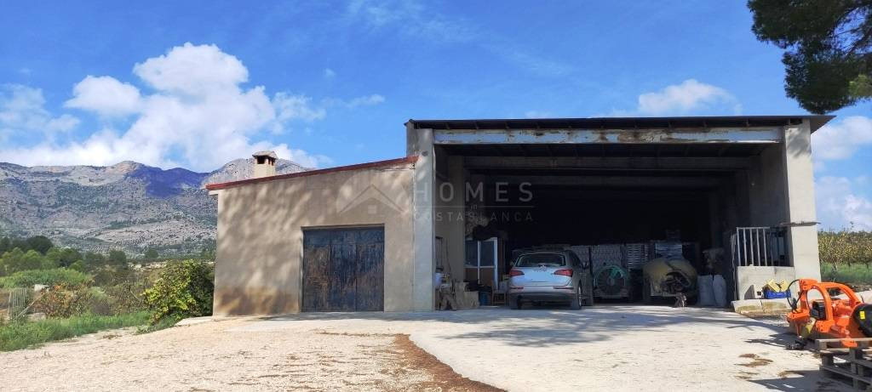
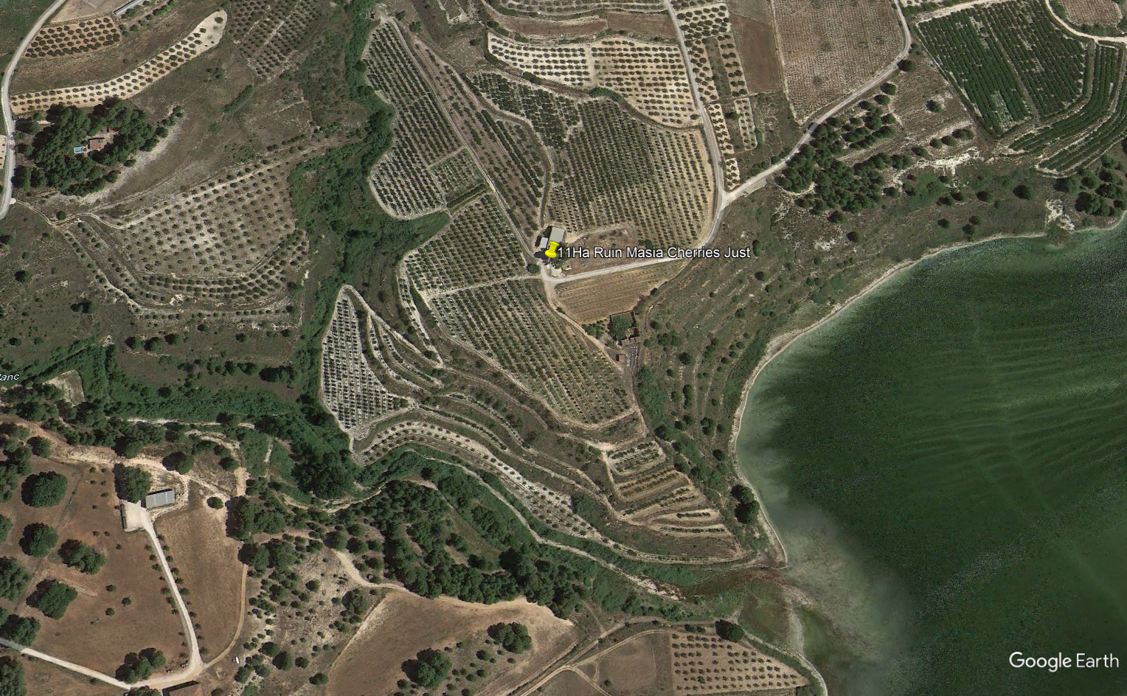
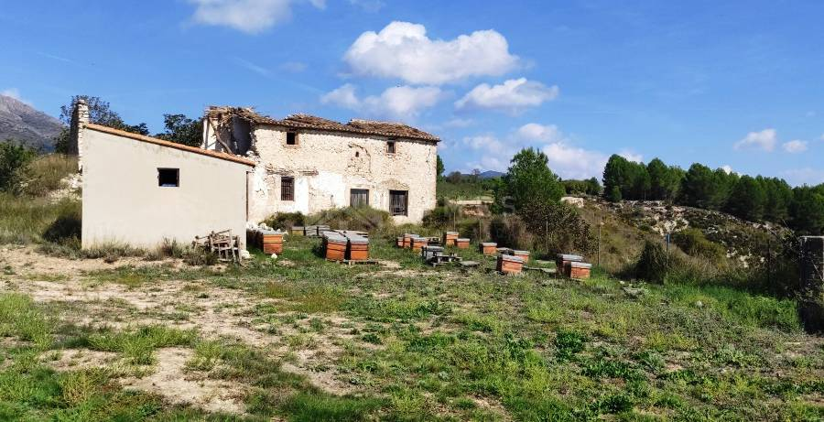
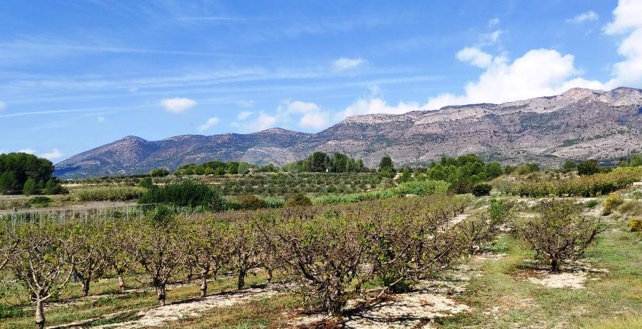
Real Estate / Land Options
Recontacted Just Camps Jan 2024 (HomesCostaBlanca) known to Sarah for 2 Years
***11 Ha Cherry Orchard Alcocer de Planes EUR 167K 280m2 Modern Warehouse + Workers quarters, Ruined Masia, direct access to Reservoir, old swimming pool needs restoration View
VIDEO
Compares to crop land Alfafara (no building) EUR 65k 4.5Ha
Cherry Orchard 2Ha Benisilli (water from cistern only) EUR 89k with stone building and smaller modern farm building
At least 4 village/town houses for renovation EUR 40k and under but probably only one closest to the sea in Benirama (20 mins drive) had medium liquidity (real estate in the villages is suffering because of collapse of cherry crop and visitors/bikers tend to stay nearer the coast at the bottom of the mountains e.g. in Adsubia and Pego).
Planes 20k View 50 mins Denia Beach, 15 mins Cherry Farm
Benirama 40K Dropped to 37K View 20 mins Denia Beack 40 mins Cherry Farm
Current price for Cherry Plantation per Ha with farm building :
1-2 Ha EUR 80K say 40k per Ha
Over 10 Ha EUR 169K say 15k per Ha
Farmland no building e,g, cereal crops
4-5Ha EUR 65k say 13k per Ha
CONCLUSION:
SCALE of 4 Ha and above rather than 1-2 Ha. Ideally 14 Ha for 10 Ha Cherries and 4 Ha alternative use.
Offer 12k per Ha with building

Slide 19
Next Steps
- At the least need an office in the region of Pego/Vall de Gallinera/Planes/Alcoi. Essential asap including to register for EU funding.
e.g. Budget EUR 15-20K rent for 2 years, EUR 30k 3 years probably better to buy up to EUR 40K.
e.g. Probably a no brainer, Planes EUR 20K, offer 13.5K – 15k looks a mess but all structural work done say 3-5K for 2 windows, 2 doors, cement stairs, plasterboard, stair rails, electrics, internet, water heating, self clearing & installation. 10% transaction tax, 1.5k transaction costs. i.e. 20-22K total. VIDEO
- Research EU Funding for Agri Climate Change Adaptation
- Contact Univ. Minnesota who seem to have much research on artificial pollination and other challenges for optimising stone fruit production.
- Simon read Los Grobos (Harvard Business Review paper) consider investment options, logistics, strategies.
- Detailed costs and business plan.

